Slide 1
Reliably Measuring Responsiveness
in the Wild
Notes:
- Intro ourselves
- Intro talk
Building user centric metrics,
Announced some metrics & APIs at Google I/O
Today: focus on responsiveness metrics & field data
- Chrome + SOASTA Collaboration
Validate metrics capture real world needs for measurement
Demonstrate that the metrics are high quality, correlate with ..
[Handoff to Nic] ...
Excited to share results of collaboration

Slide 2
When is load?
Notes:
NJ
Load and Page Load time
What are we measuring? How much does it matter?
In modern apps, how important is Page Load as part of the user experience?
Page Load time is a metric our industry has been measuring for a long time because it does matter
Slow page load = low conversion
Page Load is important part of overall user experience
Not the entirety of the user experience
Visitors to modern apps spend significantly more time interacting with site then loading
Interactions matter
Talk about recording

Slide 3
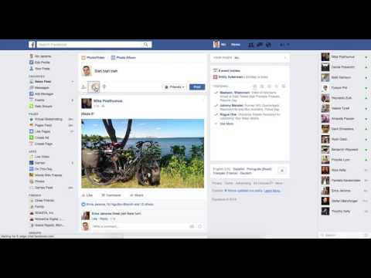
Notes:
NJ
Example of a good Load time where I still had a bad post-page-load experience
At the point it looks ready, I type, but when I click on a button, nothing happens
Event handlers haven't loaded yet, so it's not responding to my input
Rage clicks - user is getting frustrated, spamming the mouse

Slide 4
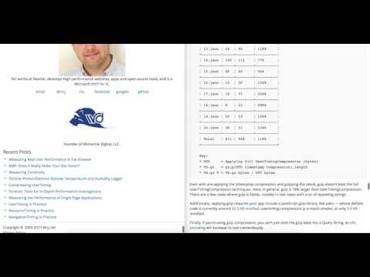
Notes:
NJ
Another aspect of Responsiveness after onload is how the site responds to interactions like scrolling.
Left page is smooth scrolling
Right page has just 100ms of delay on scroll
Right page looks janky, not silky smooth

Slide 5
Old load metrics don’t capture user experience.
We need to rethink our metrics and focus on what matters.
Notes:
NJ
Old events such as DOMContentLoaded or onload don't have as direct effect on modern apps
Traditional onload isn't as important in modern apps
SPA frameworks load content and views after onload
Even if content rendered, interaction can be blocked
e.g. handlers not attached
Main-thread CPU content
Focus on what matters
Page Load is only one part of the experience
How your app handles user input will delight or frustrate
Click resulting in no reaction frustrates users
Enough frustration and you might lose them today or forever

Slide 6

Performance only matters at Load time
Notes:
NJ
We don't want to only focus on the page load
Dev outreach; analytics; dev tools; solely focussed on this
Reality: lots of other interactions long after load: scroll, tap, click, swipe
All the time you spend on fav sites: News, Twitter, Amazon, Pinterest
Users associate performance with overall experience
Unfortunately worst experiences are most memorable
Good page load but not responding afterward, user will notice

Slide 7

My app loads in X.X seconds
Notes:
SP
misconception: putting a number on performance
I’ve measured my app’s loading perf: loads in 3s
What does that mean? which user / device and what network?

Slide 8
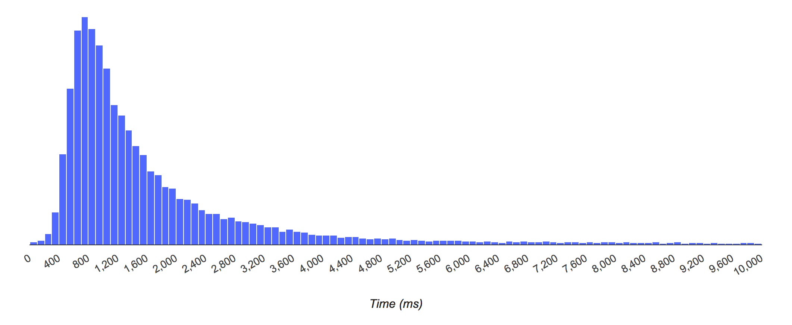
Load metrics are NOT a single number
Notes:
SP
in reality: app's load time is the collection of all the load times from every individual user
only way to represent this is as a distribution on a histogram
applies to all perf metrics
x-axis: page load time, y-axis: number of loads that had that time
not enough to look at median time, imp to consider 75th, 90th percentile users with slow loads
this histogram illustrates the difference between measuring performance in 2 different contexts

Slide 9


Performance in the Lab
Performance in the Real World
Notes:
SP
Lab vs. Real World
Lab: DT, WPT, LH, other CI
lab is important:
get sense for how changes are likely to behave in the real world
deep insight and breakdowns to track down issues
Lab Testing is necessary but not sufficient
real world messy: permutation of devices, network config, cache conditions -- impossible to simulate in lab
RUM helps understand what matters most to real users based on actual user behavior; maybe different from assumptions
map your hypotheses from the lab to the real world
SOASTA does RUM; Nic will share data from RUM later

Slide 10
Key questions
What metrics accurately capture responsiveness?
How to measure these on real users?
How to analyze data and find areas to improve?
Notes:
SP
agenda of our talk

Slide 11
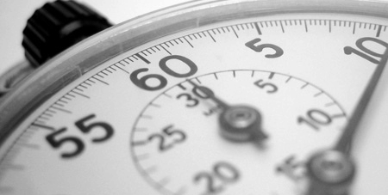
Responsiveness Metrics
Notes:
[SP]
- intro core new responsiveness metrics and underlying concepts

Slide 12

Queueing Time
Notes:
SP
- Nic demo - imp element not interactive; to understand why
- Checkout queue holdup
- Long tasks holdup all other tasks in queue

Slide 13
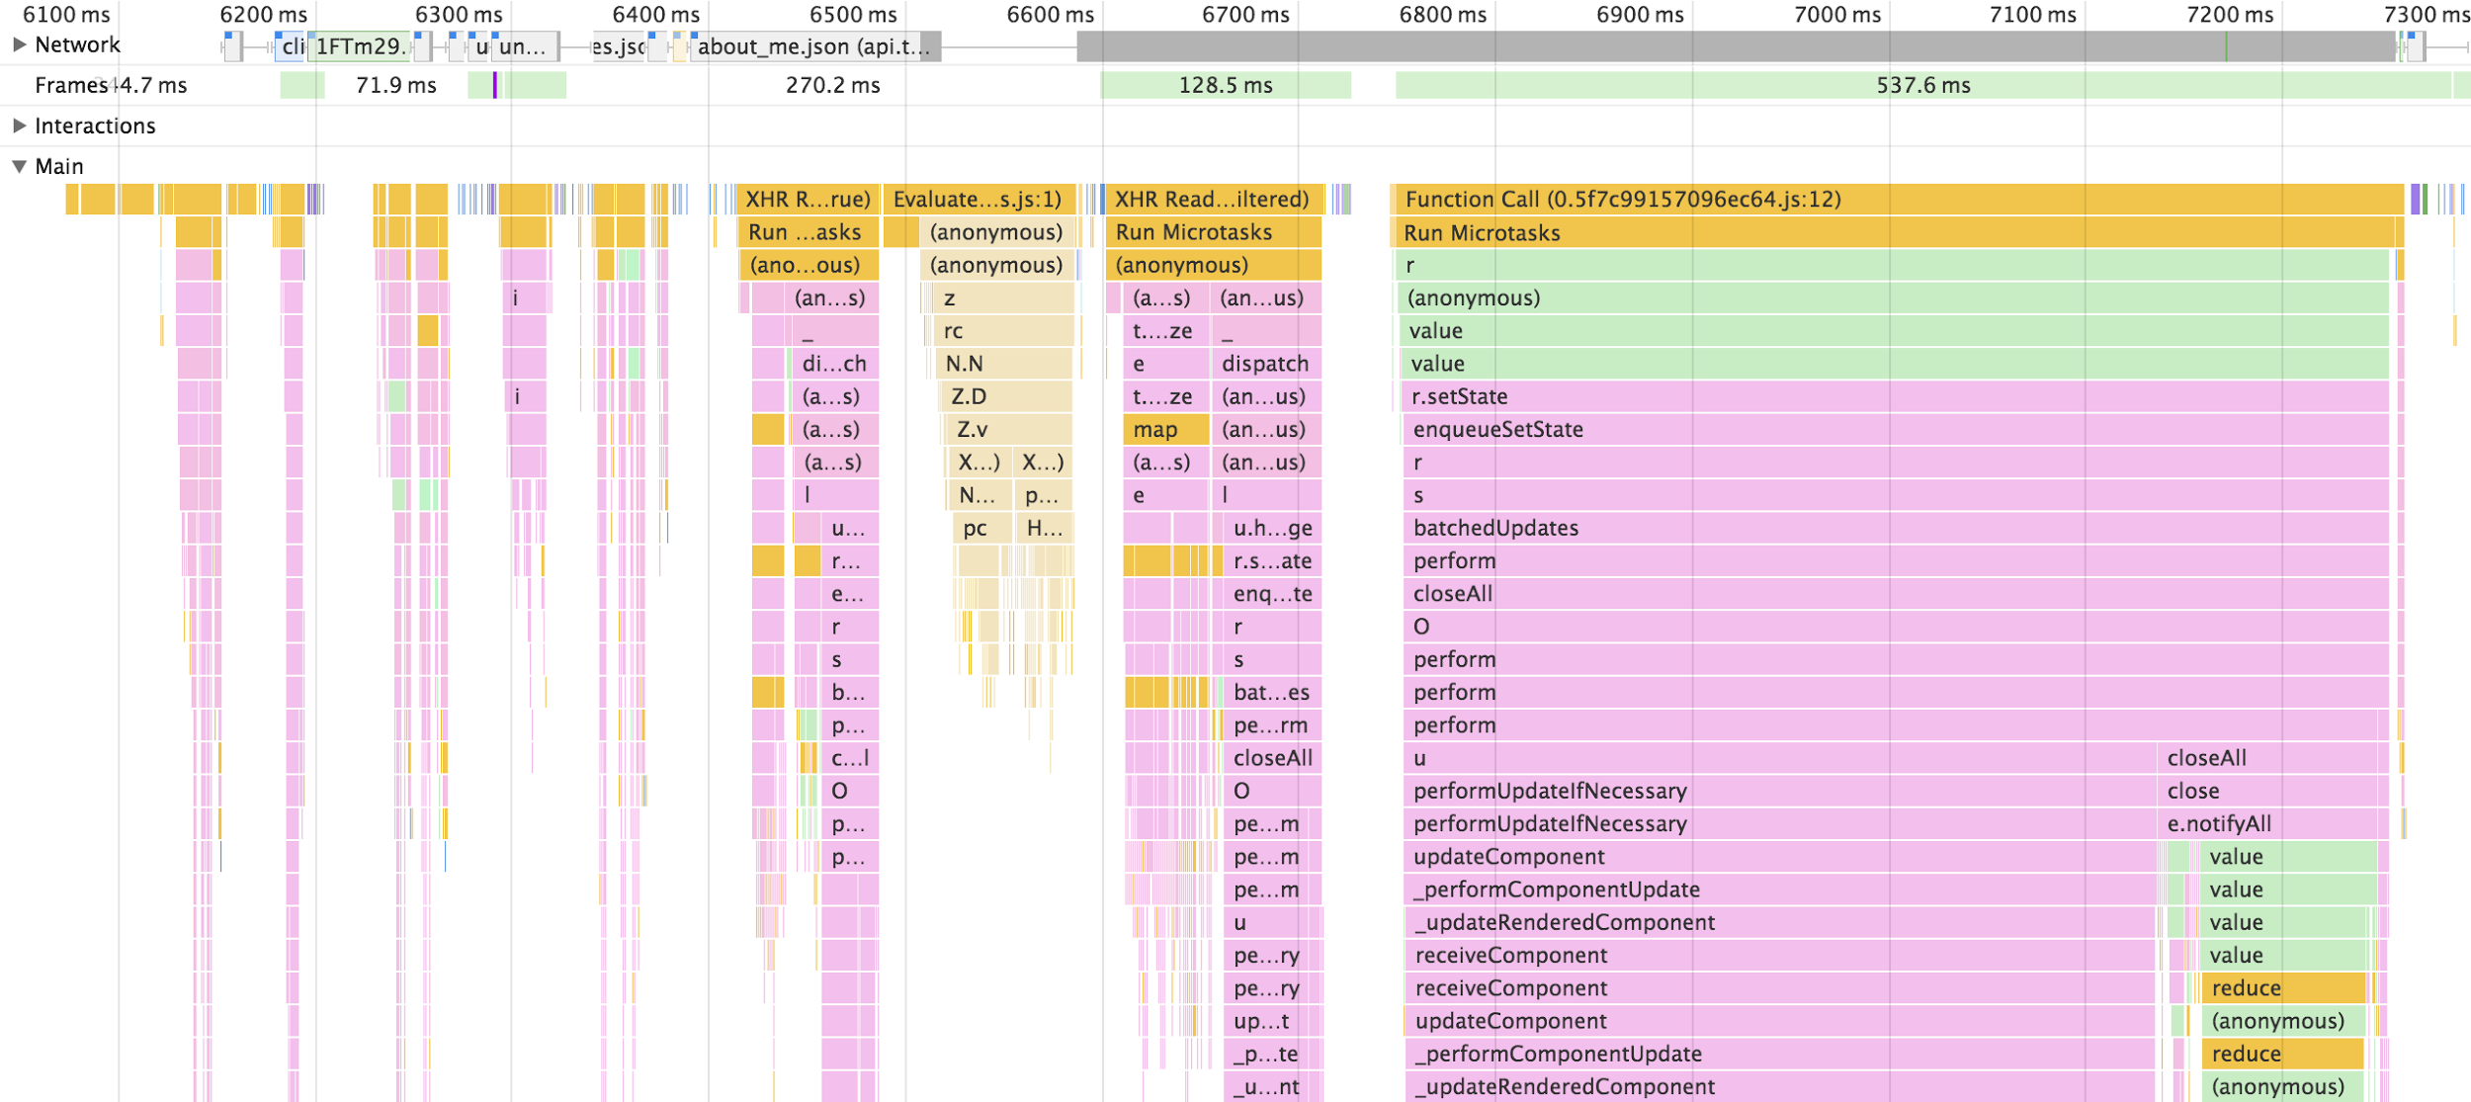
Short Tasks
Long Tasks
Notes:
SP
DT style, layout, paint, script: all on main thread
most interactions: taps, clicks & even animations - need main thread
long script is executing on main, then interactions blocked in queue
manifests as delays / jank [saw in demos]
[refer back to bank queue interaction] $100 in pennies vs. paycheck cashed

Slide 14
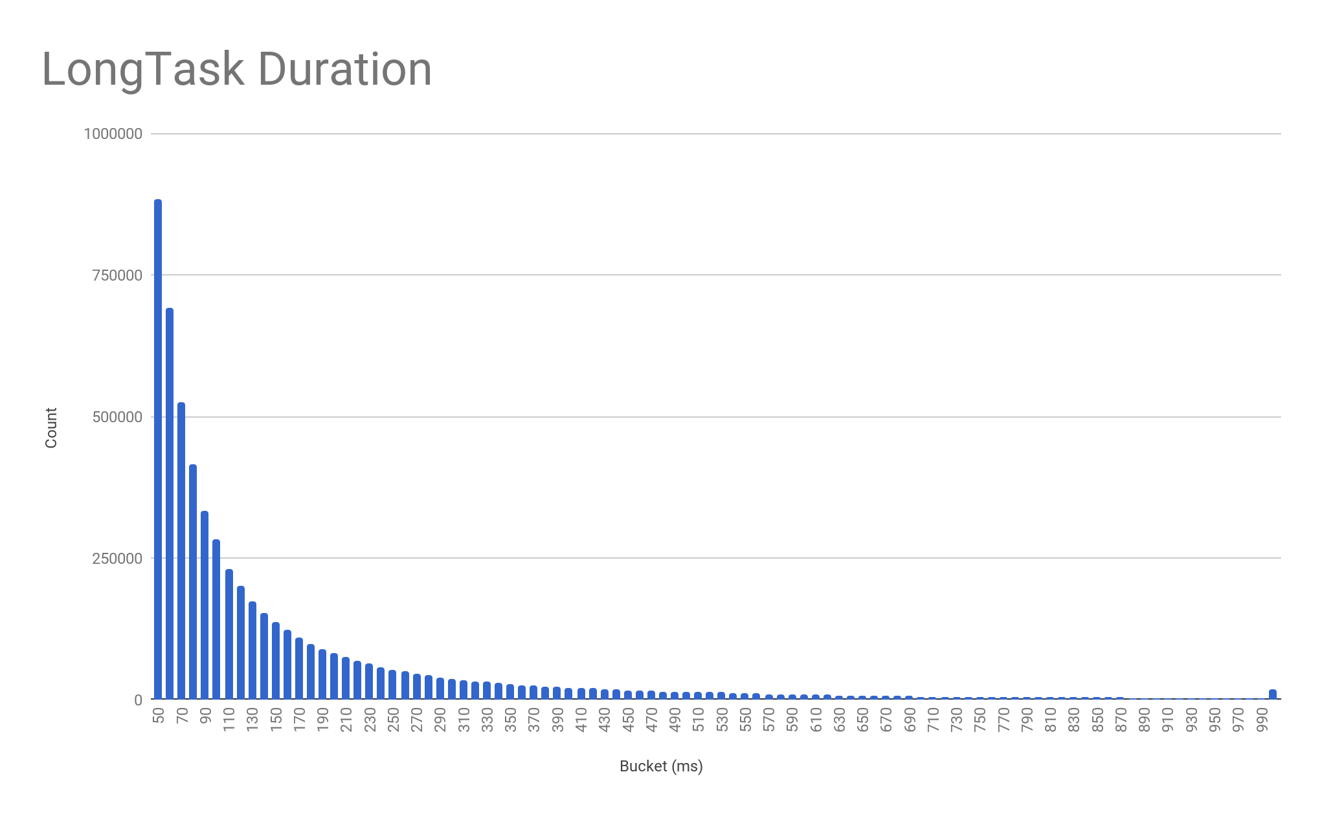
Millions of Long Tasks
Long Tasks on 3 customer sites (daily average)
Site 1 (Travel): 276,000
Site 2 (Gaming): 200,000
Site 3 (Retail): 593,000
Notes:
SP
We’ve been collaborating with SOASTA; case studies with 3 selected customer sites
Data backs up the fact that there are a LOT of long tasks on the web today;
daily average: hundreds of thousands of long tasks
histogram shows the distribution: long tail of painful tasks really hurting users

Slide 15
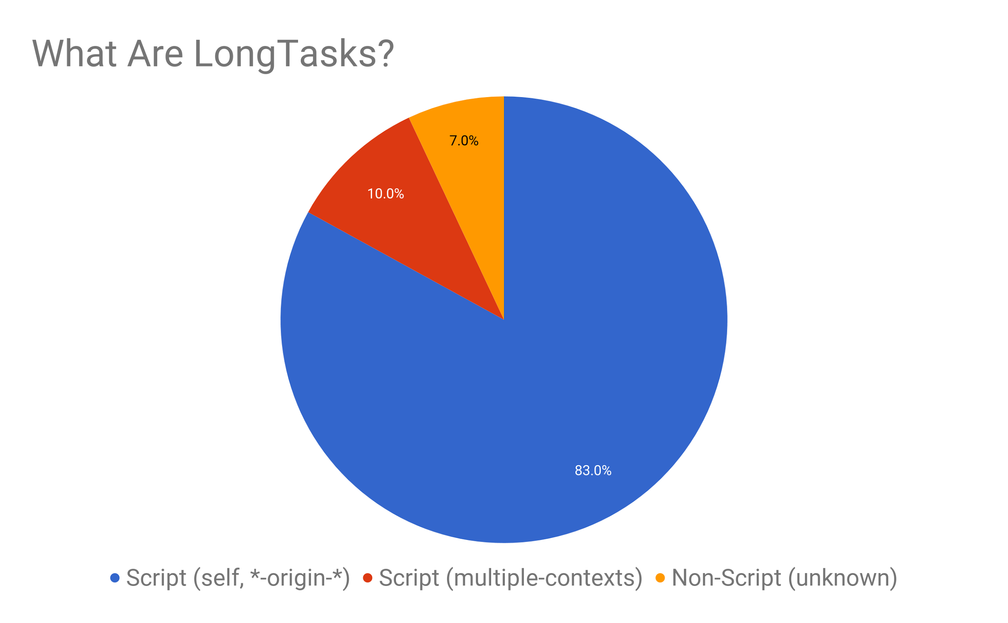
Notes:
SP
long tasks: cause of most responsiveness issues. But why do they happen?
script is most common reason: parse & eval
Again, sample data based on study; representative of real world
will talk about what the slices mean later

Slide 16

60 fps: An Elusive Dream
Notes:
SP
50 ms chunks ensures R of RAIL. Tasks should be broken up ...
what about 60fps? want users to have 60fps smooth experiences. why not 16ms?
falling short of smooth 60fps animations v small subset of responsiveness issues
if there’s a couple of 200ms script evals that get in the way of user interaction -- vastly worse user exp
starting with getting egregious long tasks under control is the first step in the quest for 60fps
if animating on main -16ms is shared with browser.
Bright Future: more things are move off the main thread;
will take many years before main thread contention is not an issue

Slide 17

Real User Measurement (RUM)
Notes:
NJ
RUM is concept of being able to measure real users in the wild
Gather data in aggregate
Real visitors on real devices loading your pages
Look at trends and slice-and-dice to understand good and bad user experiences
How can we use RUM to gather data on measuring responsiveness?

Slide 18
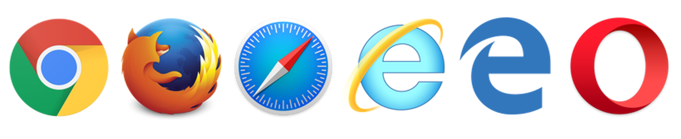
Real world measurement
with Web Performance APIs
Notes:
NJ
Utilize browser performance APIs
W3C standards
Modern browsers
NavigationTiming, ResourceTiming, UserTiming
Use these building blocks to measure beyond page load
Gain insight into how our visitor’s happiness is affected by their experience, interactions
What about measuring everything that happens after onload?

Slide 19
New Performance APIs and Metrics
Performance Observer
LongTasks
Time to Interactive
Input Latency
Notes:
NJ
Two new browser performance APIs
Use new APIs to build and track new two metrics
First new metric, TTI, is a way of measuring not only when your app loads, but when the user could interact with it and have a good experience
Look at how we can measure Input Latency
Getting beyond onload
How long your app takes to respond to user input
If there are problems, what caused them

Slide 20

Performance
Building Blocks
Performance
Observer
High Resolution
Time
Performance
Entry
Notes:
NJ
Start out with PerformanceObserver
Way of getting notified of new performance data
Utilize building blocks
High Resolution Time API
performance.now()
Higher-resolution, monotonically non-decreasing timestamp
Fancy way of saying better than Date.now() because it's not affected by user clock

Slide 21
PerformanceTimeline vs PerformanceObserver
// PerformanceTimeline
var entries = performance.getEntriesByType("resource");
// PerformanceObserver
var entries = [];
const observer = new PerformanceObserver((list) => { for (const entry of list.getEntries()) {
entries.push(entry); } }); observer.observe({entryTypes: ['resource']});
Notes:
NJ
Why use PO?
Consumed existing API like ResourceTiming you've used an older interface called PerformanceTimeline
Synchronous method to gather all entries from RT buffer
Lite version of developer tools
Recorded for every page load
PerformanceObserver new way
“observe” -- be notified -- of new Performance Entries.
More efficient
Not polling
Control your own buffering
Immediate notification of new data
Code examples

Slide 22
LongTasks
https://github.com/w3c/longtasks
Notes:
SP
first class Web performance API to report on presence of “Long Tasks”; indicates cause

Slide 23

Bad Workarounds
Timeout polling
rAF loop
Issues
Performance overhead
Battery drain
Precludes rIC
No attribution
Notes:
SP
devs figured out that main thread busy causes responsiveness issues
workarounds widely used:
eg. 10ms periodic timer and measure delays
continuously Measuring time in rafs and looking for delays
These workarounds indicate main thread busy - BUT terrible:
high cost - perf overhead

Slide 24
LongTasks via PerformanceObserver
const observer = new PerformanceObserver((list) => { for (const entry of list.getEntries()) { sendDataToAnalytics('Long Task', { time: entry.startTime + entry.duration, attribution: JSON.stringify(entry.attribution), }); } }); observer.observe({entryTypes: ['longtask']});
Notes:
SP
API addresses all of these issues
- usage
- callback; observe “longtask”;
every time main thread > 50ms - queue entry
invoke callback async with list of queued entries
long tasks - available on chrome stable - try it out!
identify responsiveness issues on your app: full page including child iframes

Slide 25
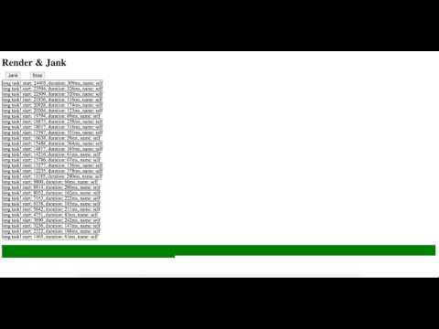
https://w3c.github.io/longtasks/render-jank-demo.html
Notes:
Demo
long tasks interrupt rendering
inject arbi long script at random intervals during rendering
each time long task: queue perf entry; async callback with PerfEntry;
print out main attributes of PerfEntry: startTime, duration

Slide 26
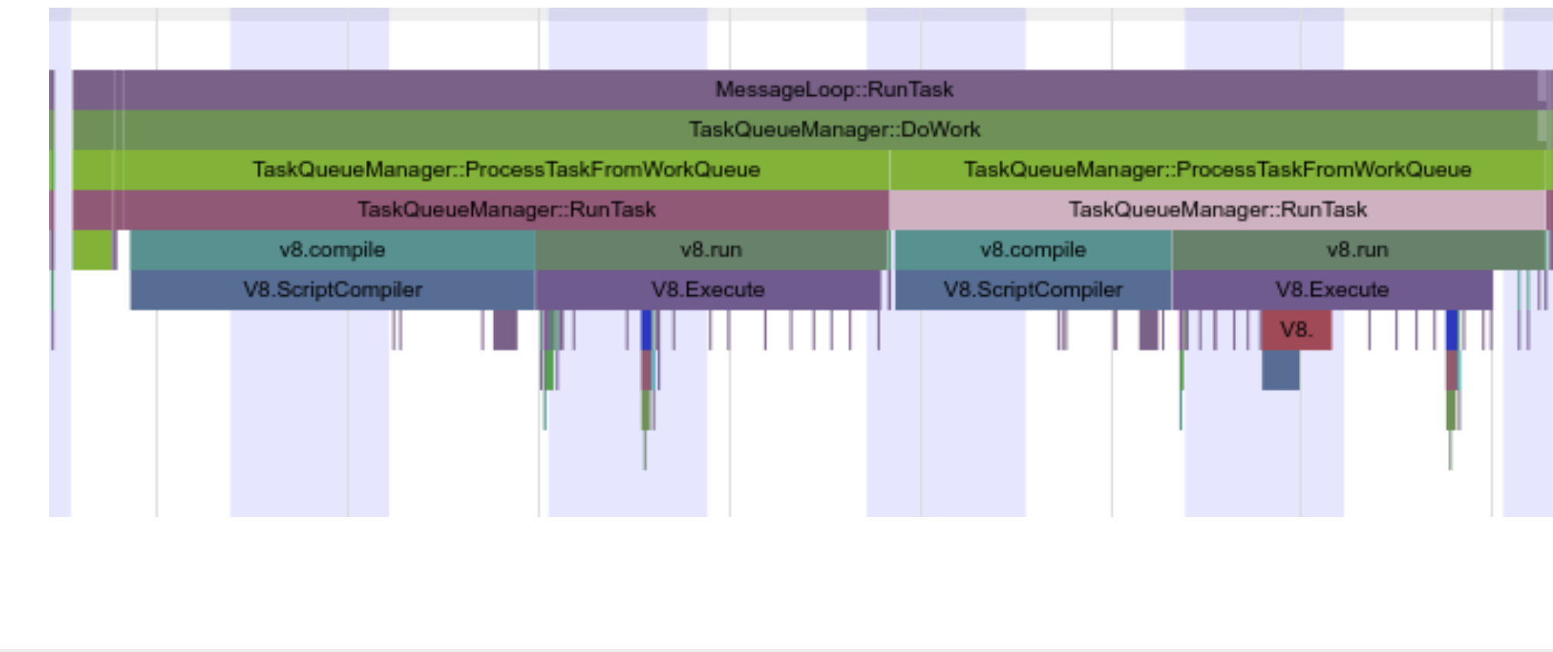
script 1
script 2
Multiple sub-tasks (scripts) within a long task
Notes:
Long tasks can in turn be composed of multiple sub-tasks;
to understand why - need to look into these sub-tasks

Slide 27
Attribution: Who?
“Minimal Frame Attribution” with name
self, same-origin-ancestor, same-origin-descendant, cross-origin-ancestor, cross-origin-descendant, multiple-contexts, unknown etc.
Notes:
SP
to understand why - need attribution
one piece of attr is “name”: min frame attr
Point to the overall frame to blame on the whole
- can be first party or third party iframe - imp piece of attr
TODO: What is unknown

Slide 28
Attribution: Who And Why?
Detailed attribution with TaskAttributionTiming
attribution[]
containerType: iframe, embed, object
containerSrc: <iframe src="http://..." />
containerId: <iframe id="ad" />
containerName: <iframe name="ad-unit-1" />
Notes:
SP
2nd attr: understand why?
Pointing to the type of work involved in the task and its associated frame context:
attribution field has a set of TaskAttributionTiming objects
shows containertype (...) and info to identify the container - src, id, name etc.

Slide 29
More Attribution: Coming soon!
Detailed attribution with TaskAttributionTiming
attribution[]
containerType: iframe, embed, object
containerSrc: <iframe src="http://..." />
containerId: <iframe id="ad" />
containerName: <iframe name="ad-unit-1" />
scriptUrl: https://connect.facebook.net/en_US/fbevents.js:97
Long Tasks V2!
Notes:
SP
V2 API -- a major improvement is that we will actually long scripts with scriptUrl
if multiple scripts ran within long tasks - one TaskAttributionTiming entry for each long script.

Slide 30
LongTasks: Usage Tips
Measuring during page load: Turn it on as early as possible (e.g. <head>)
Measuring during interactions with a circular buffer
First-party (“my frame”) LongTasks give only duration
Third-party other-frames provide attribution if the IFRAME itself is annotated via id, name or src.
Notes:
NJ
LongTasks available in Chrome
Experimenting with API, collecting data from wild
Measuring during page load
Turn it on as early as possible (e.g. <head>)
Use message-queue pattern to hand off to analytics scripts
Measuring during interactions:
Use a circular buffer to hold on to the last N entries
See our Input Latency sample later for a great way to use this data
Split into first and third party
First-party
My frame
Something you can control
Third-party
Other content
Attribution
Hold them accountable

Slide 31
Time to Interactive
Is it Usable?
Notes:
NJ
Build on LongTasks to give us a new meaninginful metric
onload just one indication of page load, might not be relevant
A better way to measure your visitor’s experience is to understand when they’d be able to interact with the page.
In other words, when is your app Usable?
This is what we mean by Time to Interactive.

Slide 32
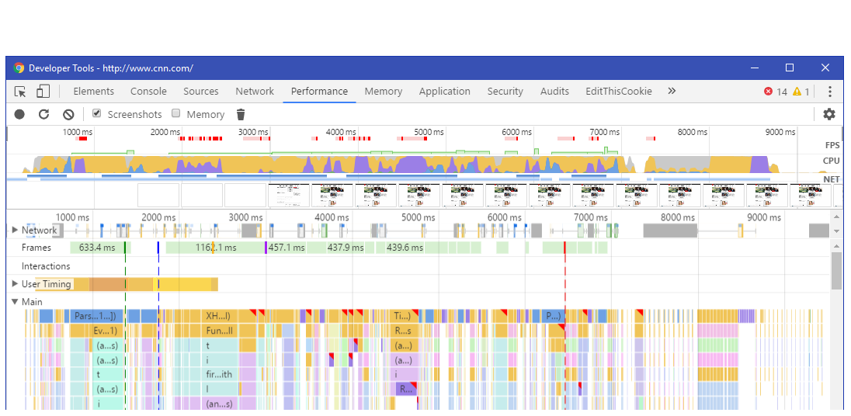
Time to Interactive
User Sees Content
Not Interactive Until Here
Notes:
NJ
Visual explanation
Developer tools of a page load
Main content starts becoming visual at 3 seconds
User might think they can interact
Main thread is pegged until 9 seconds
User clicked before then, they'd possibly have a bad experience (no response to their input) or janky scrolling

Slide 33
Time to Interactive: Lower Bound
When does the page appear to the visitor to be interactable?
Start from the latest Visually Ready timestamp:
DOMContentLoaded (document loaded + parsed, without CSS, IMG, IFRAME)
First Paint, First Contentful Paint
Hero Images (if defined by the site, important images)
Framework Ready (if defined by the site, when core frameworks have all loaded)
Notes:
NJ
To measure Time to Interactive
When does the page appear to the visitor to be interactable? We’ll call this Visually Ready. Lower bound
After that point, if the user were to try to interact with the page, would they have had a good experience? This will be Time to Interactive.
Indicators of the Lower Bound
Some from the browser, some from the site
DOMContentLoaded when all scripts have loaded
Paint metrics
First time visitor might think the page is ready
Site hints
Hero Images
Framework Ready

Slide 34
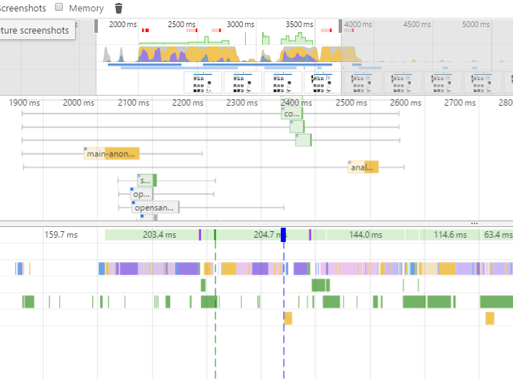
Hero Images
Framework Ready
Visually Ready
First Paint
DOM Content Loaded
Notes:
NJ
Visual explanation
Last of the events is the lower bound
Modern frameworks like Angular

Slide 35
Time to Interactive: Measuring
What's the first time a user could interact with the page and have a good experience?
Starting from the lower bound (Visually Ready) measure to Ready for Interaction where none of the following occur for your defined period (e.g. 500ms):
No Long Tasks
No long frames (FPS >= 20)
Page Busy is less than 10% (setTimeout polling)
Low network activity (<= 2 outstanding)
github.com/GoogleChrome/tti-polyfill
github.com/SOASTA/boomerang/tree/continuity
Notes:
NJ
After lower bound, What's the first time a user could interact with the page and have a good experience?
Time to Interactive
Different projects playing with TTI definitions -- Chrome’s Lighthouse, Webpagetest, etc.
Core metrics of how can we measure the page isn’t busy?
In order to have a good experience, we need a block of time after Visually Ready where the main thread is not too busy to respond to input
Use LongTasks if available
If not available, fall back to other inefficient ways of monitoring
What we do is we look for periods where none of them occur for a decent amount of time, e.g. 500ms
Period of 500ms where nothing happened after Visually Ready, TTI
May happen before or after onload
Chrome and SOASTA polyfills, give feedback

Slide 36
Input Latency
Measuring bad user experiences
Interactions (scrolls, clicks, keys) may be delayed by script, layout and other browser work
Latency can be measured (performance.now() - event.timeStamp)
Latency can be attributed via LongTasks
Notes:
SP
Input Latency: metric that indicates when imp interactions -- clicks, taps etc -- get pushed out
app devs want to know critical user interactions - eg. buy button -> checkout page in amazon, pin on pinterest, compose in gmail
these are imp interactions for those apps
ideally first class API for this
possible to get insight into this today with event.timestamp in handler & connecting with longtasks

Slide 37
Measure input latency: event.timeStamp and performance.now()
const subscribeBtn = document.querySelector('#subscribe'); subscribeBtn.addEventListener('click', (event) => { // Event listener logic goes here... const lag = performance.now() - event.timeStamp; if (lag > 100) { sendDataToAnalytics('Input latency', lag); } });
Notes:
SP
compare event.timeStamp with cur time in event handler
event.timestamp: best guess of when event created: user tapped screen
diff indicates time spent waiting in main thread queue
eg. >100 send to analytics

Slide 38
Input Latency
Determining the cause via LongTasks:
Turn on PerformanceObserver
Watch for input delays
Find LongTasks that ended between event.timeStamp and performance.now()
Sample code:
github.com/nicjansma/reliably-measuring-responsiveness-in-the-wild/
Notes:
SP
Further .. use longtask perf observer to see if longtasks within the same time frame, they're likely the culprit.
see linked sample code

Slide 39

Real World Data
Notes:
NJ
Now that we’ve talked about how great our ideas are, let’s see what kind of data they can give us in the real world.
Case studies Long Tasks as well as the Time to Interactive in the wild

Slide 40
Case Studies
3 sites over 1 month
Site 1: Travel (ads, social)
Site 2: Gaming (ads, social)
Site 3: Retail (social, 3p, spa)
Notes:
NJ
Profiled several sites
Different focus and third parties
These are not your site -- data will look different than your site

Slide 41
18+ million LongTasks
Notes:
NJ
Tracked over 18 million long tasks
100,000+/day on each site
Each of these affects part of the user experience, onload, or post-load

Slide 42
Duration Percentiles:
50th: 106 ms
75th: 208 ms
90th: 427 ms
95th: 666 ms
99th: 1,712 ms
Range: 50 to 10+ seconds
Notes:
NJ
Most long tasks 50-100ms
While 50-100ms might not seem like a long time, even that short has a direct effect on page loads and interactions
If you remember the demo at the beginning, I was showing just a 100ms work during scroll -- this led to a very janky bad experience
90th percentile are 4x the median, over 400ms, users are getting very unpleasant experiences for interactions like clicks
We also saw long tasks seconds long, these happened more often on mobile
LT track some very unlpeasant user experiences

Slide 43
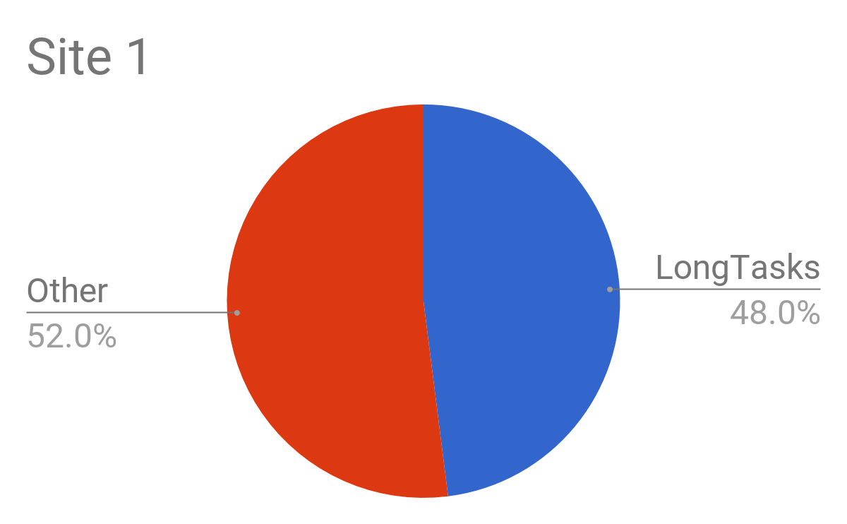
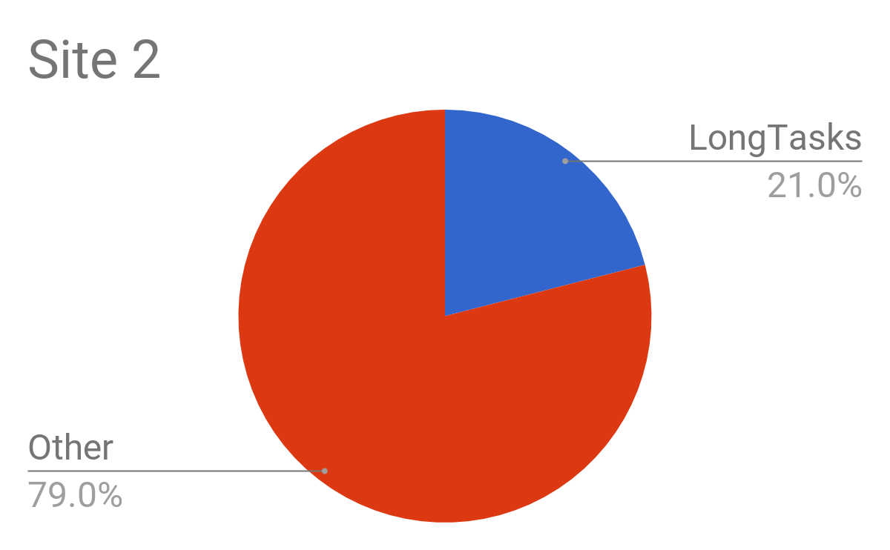
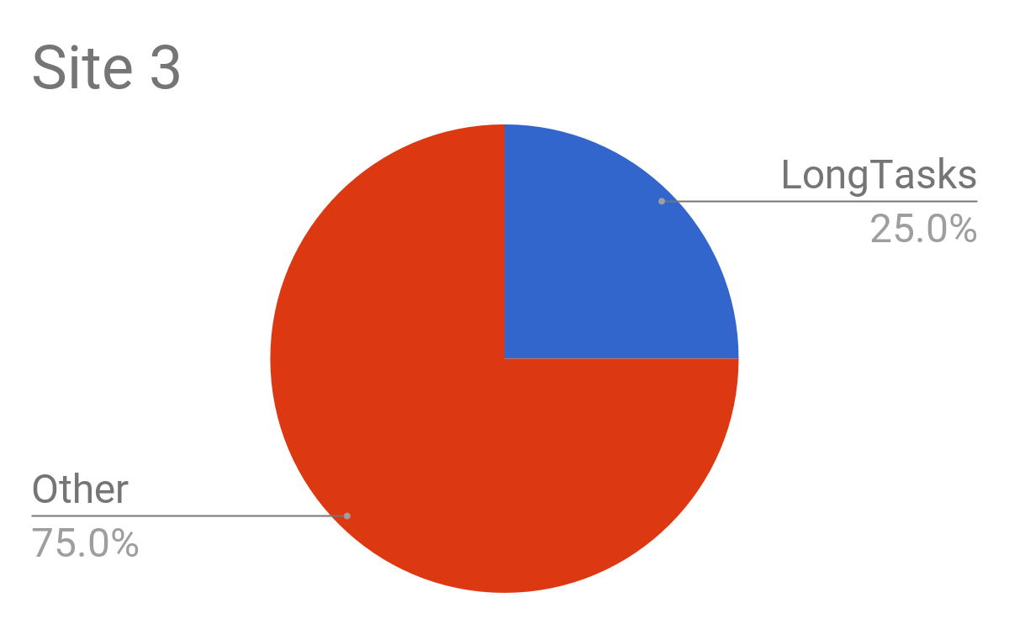
LongTasks as % of Front End Load Time
Notes:
NJ
When do LongTasks happen?
They could happen any time during your page load process or beyond.
We split out Long Task that happened up through the load even in the browser
LongTasks often accounted for 21-48% of the Front End Load Time

Slide 44
LongTasks directly delay
Time to Interactive.
Notes:
NJ
Don’t focus just on network loading
LongTasks on critical path
Directly delays onload and Time to Interactive since on main thread

Slide 45
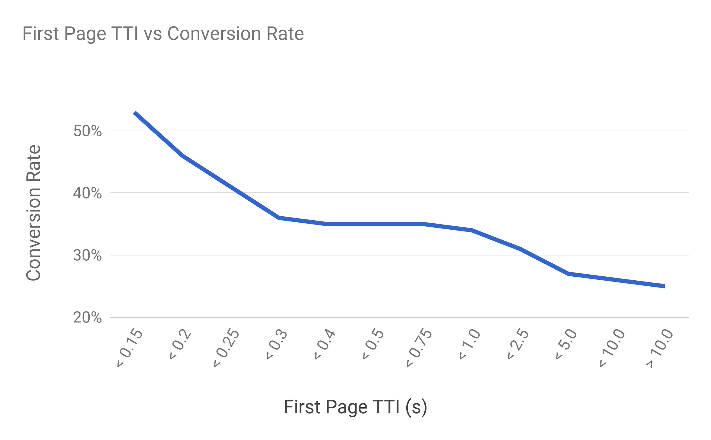
Notes:
NJ
TTI compared to conversion rate
Conversion rate is how often a user takes an action like buys a product or visits a certain # of pages
Lower the first page TTI is, the higher the overall conversion rate

Slide 46
Time to Interactive has
high correlation with overall conversion rate.
Notes:
NJ
Translates directly into revenue

Slide 47
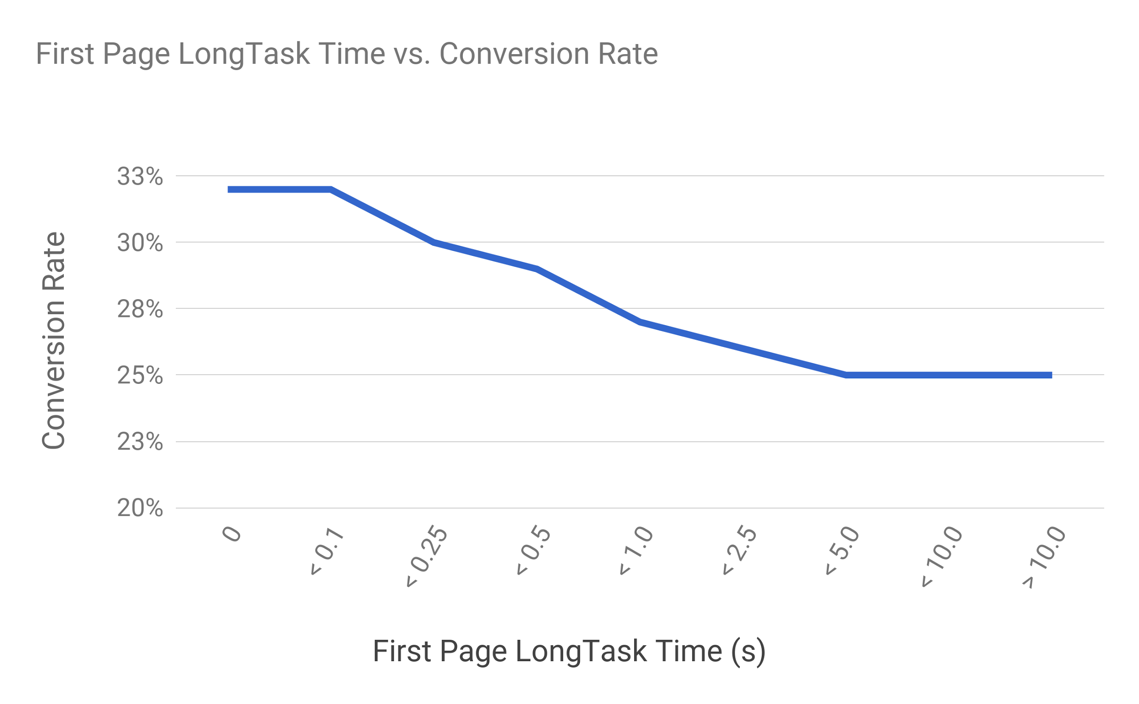
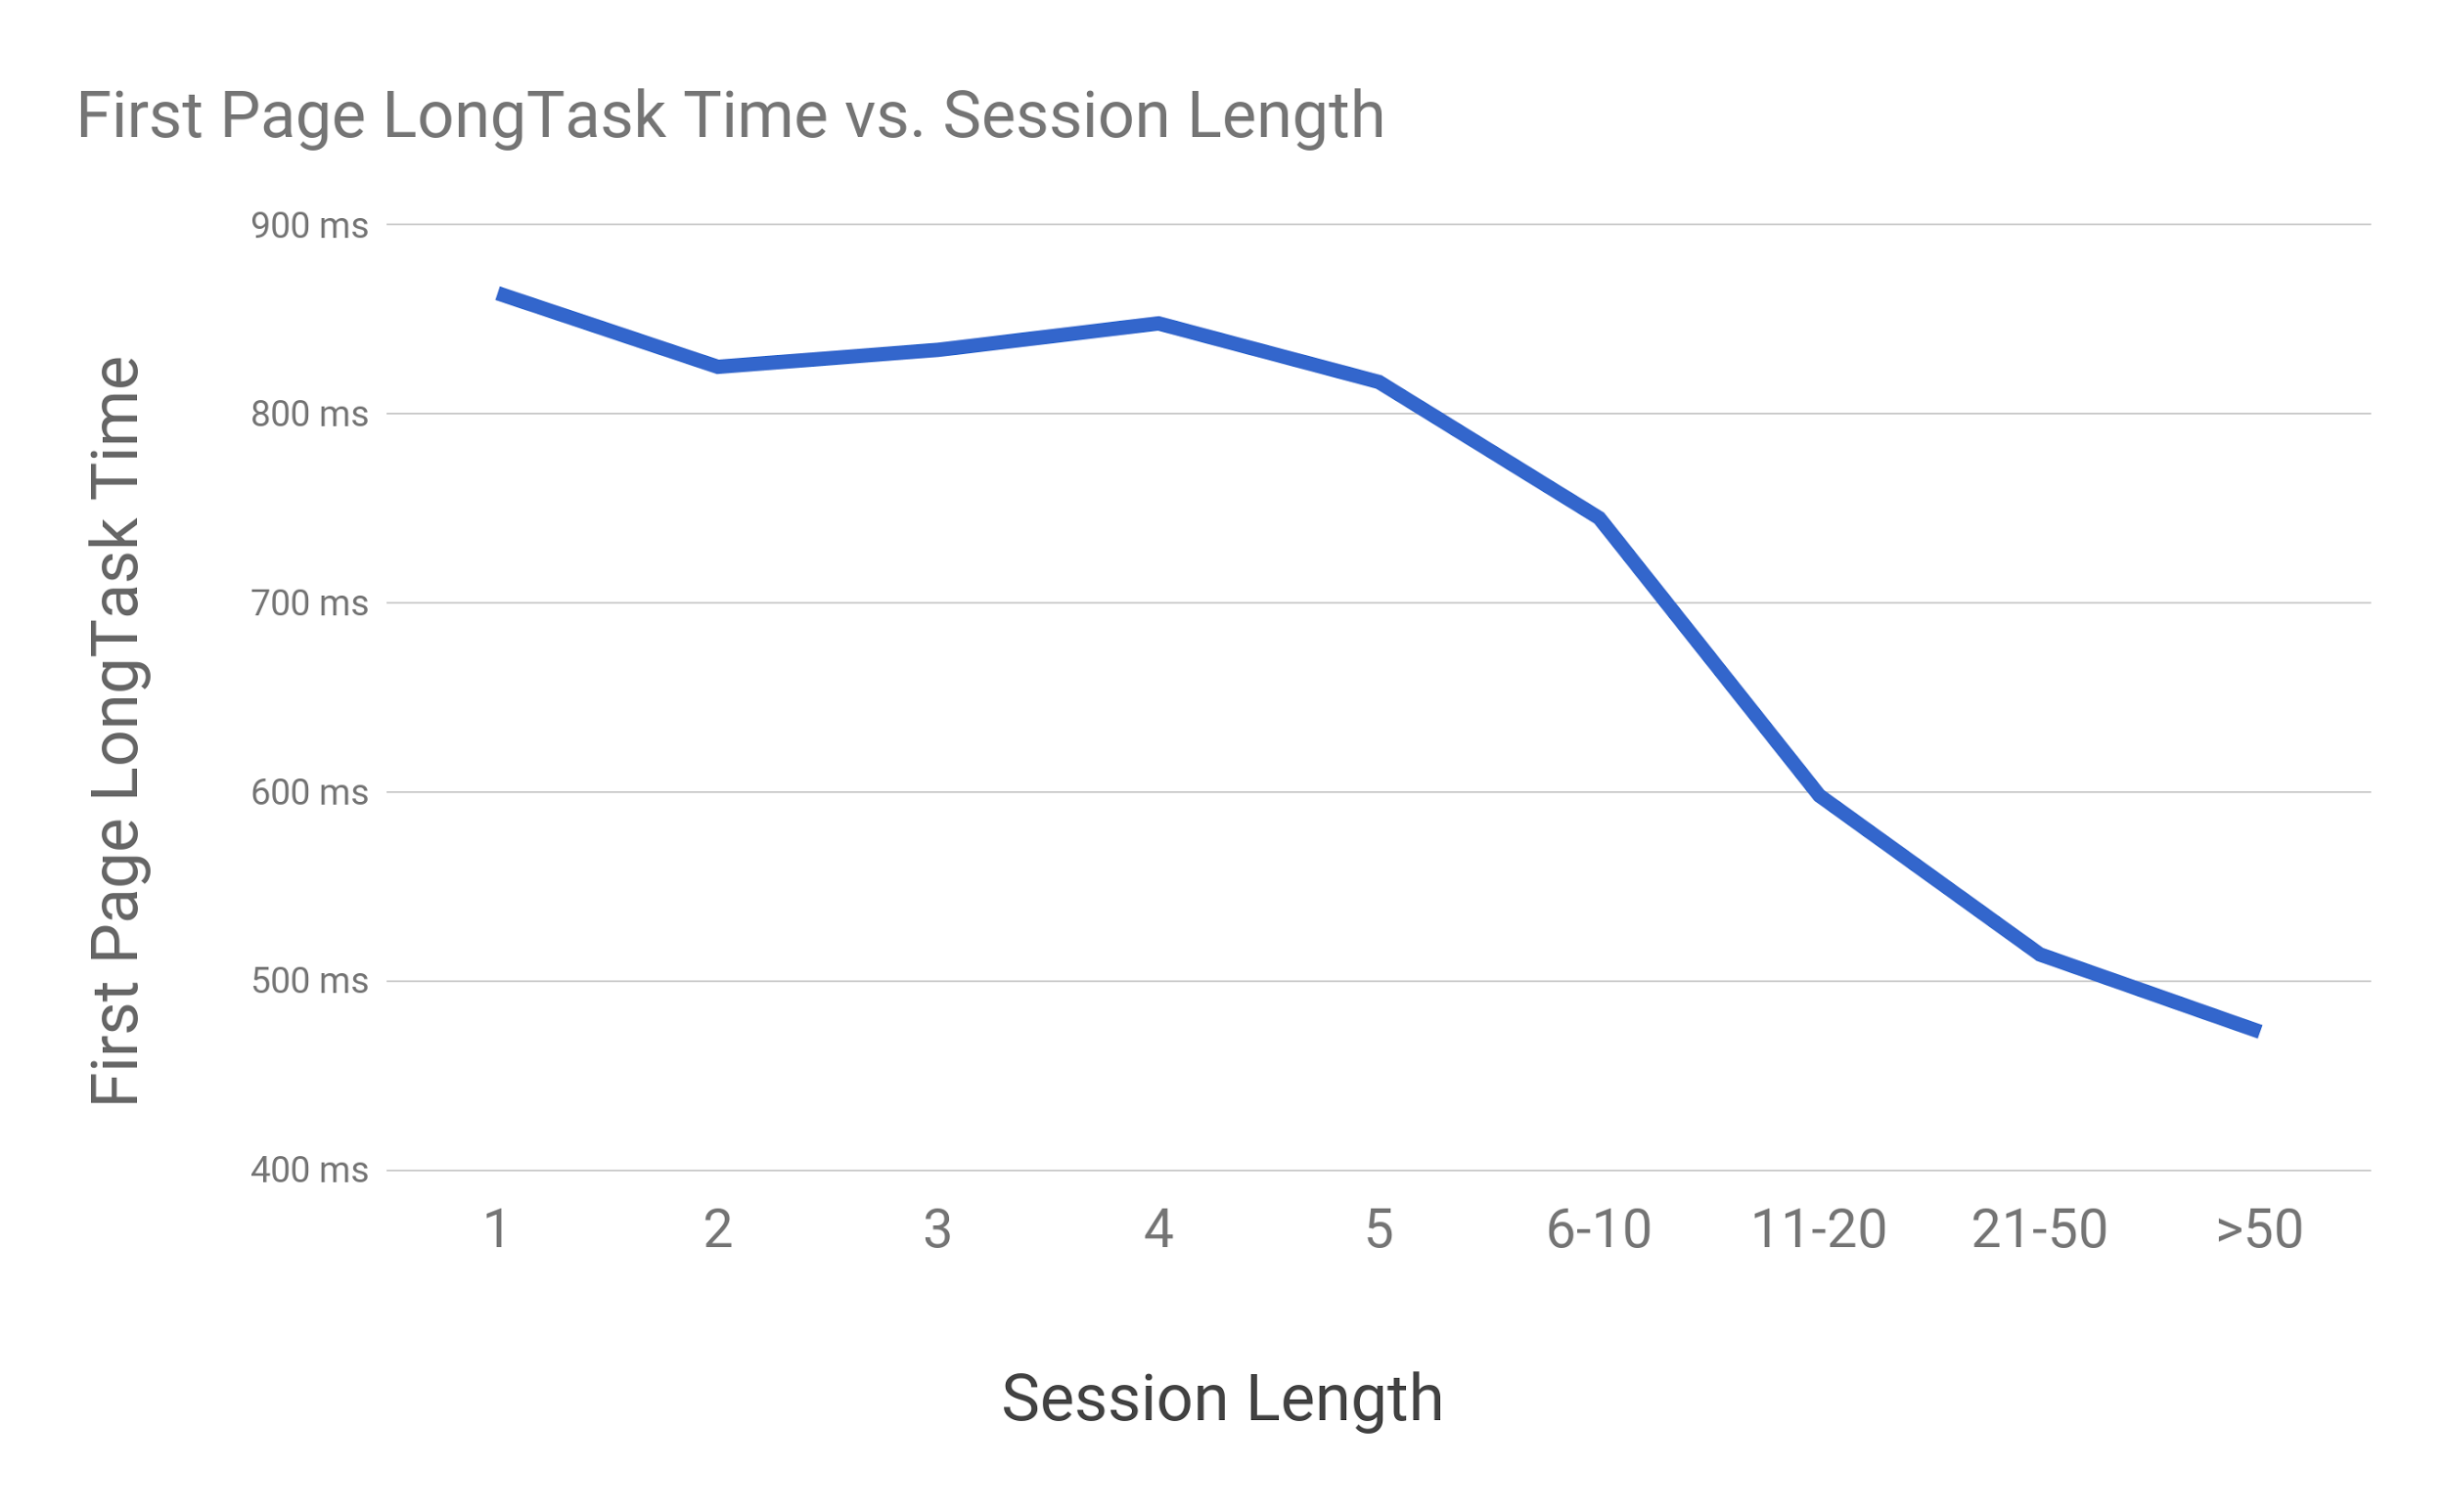
Notes:
NJ
LongTasks a significant portion of TTI
See the same thing, where the first page’s TTI has direct effect on conversion rate and session length

Slide 48
First impressions matter:
as first-page LongTask time increased, overall Conversion Rate decreased
Notes:
NJ

Slide 49
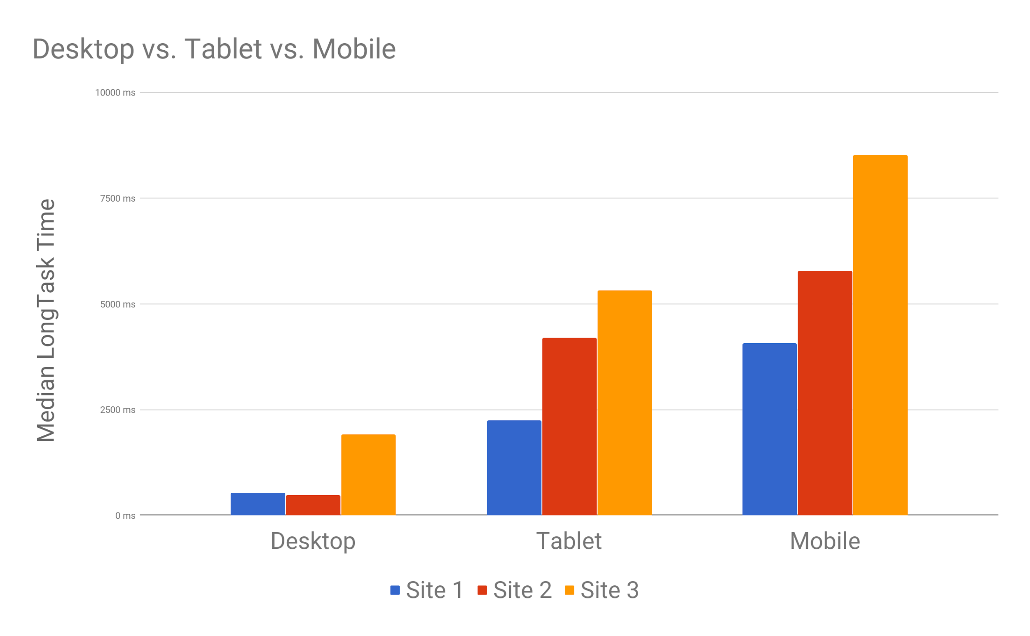
Notes:
NJ
LongTasks are even more prevalent on mobile that on desktop
Related to the reduced processing power.

Slide 50
Mobile devices could see 12x LongTask time as Desktop.
Notes:
NJ
In some cases, mobile devices see 12x LongTasks duration versus desktop
You’ve seen this on your own devices
LT can immediately point to the causes

Slide 51
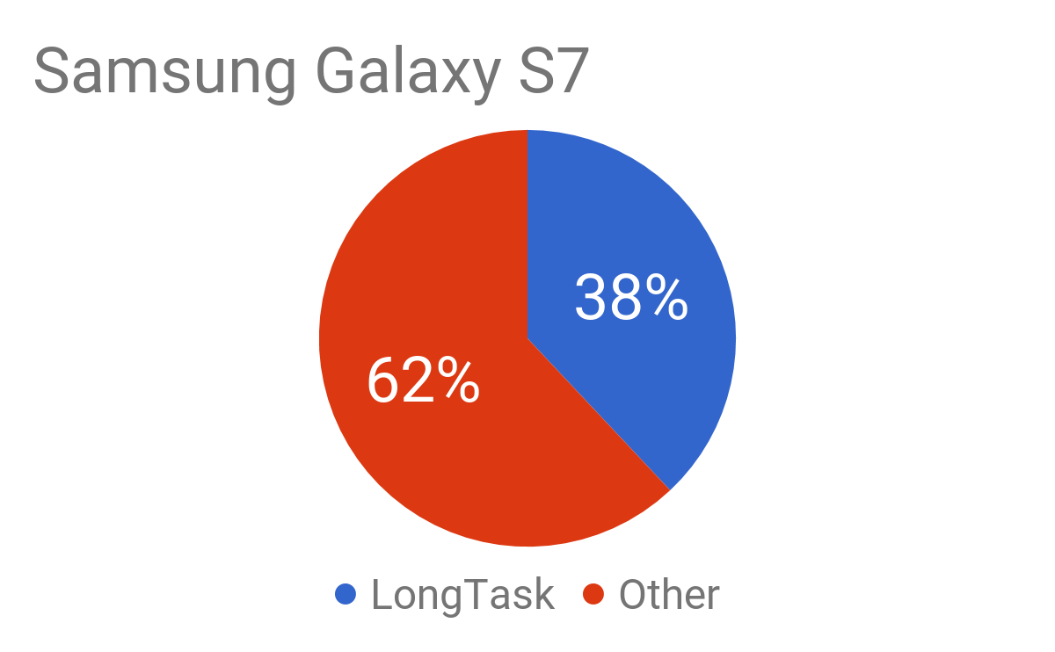
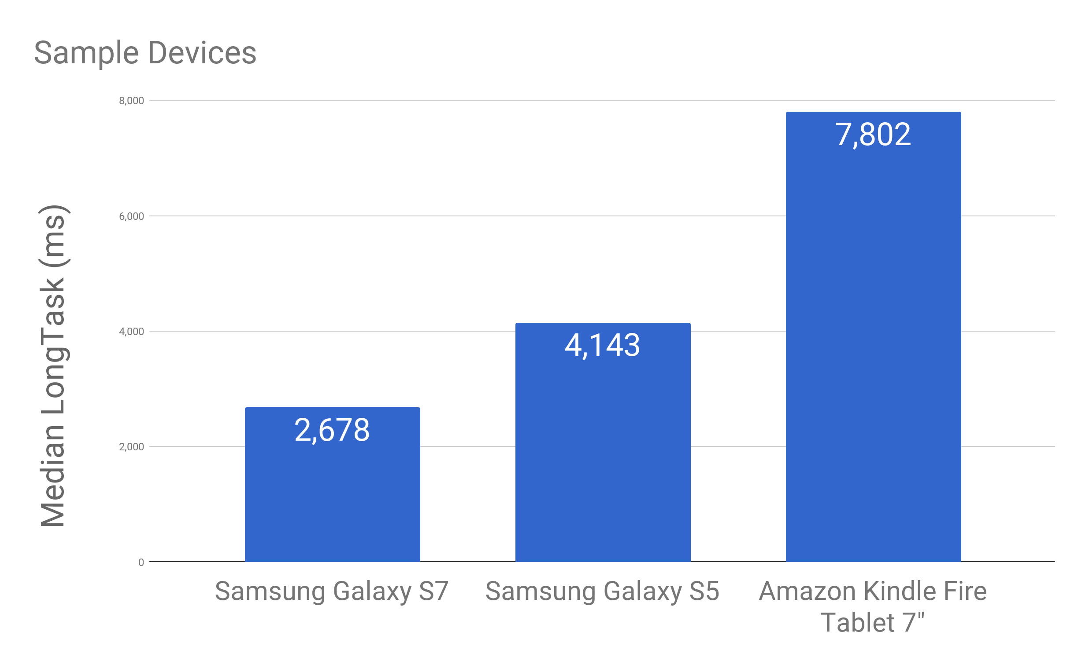
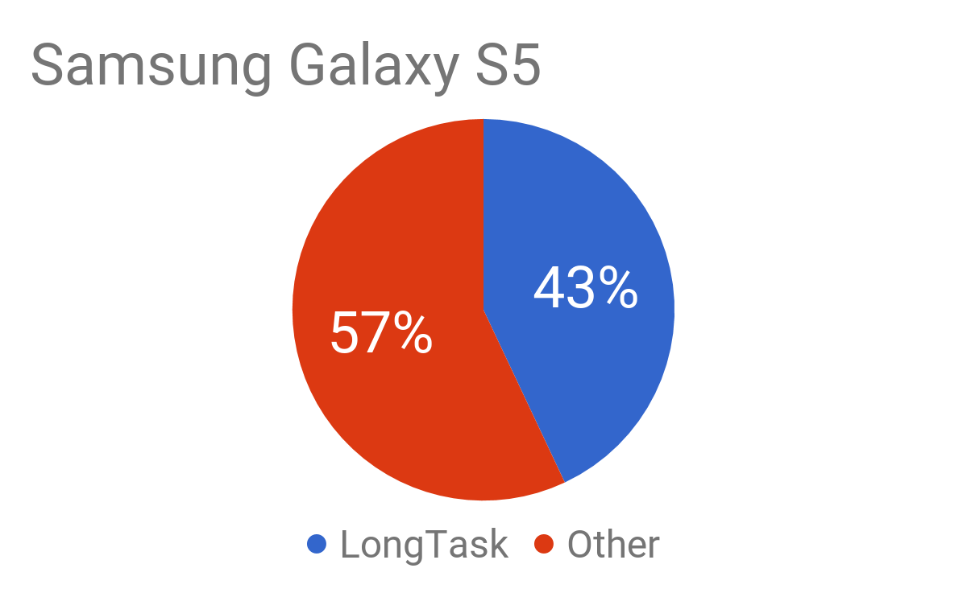
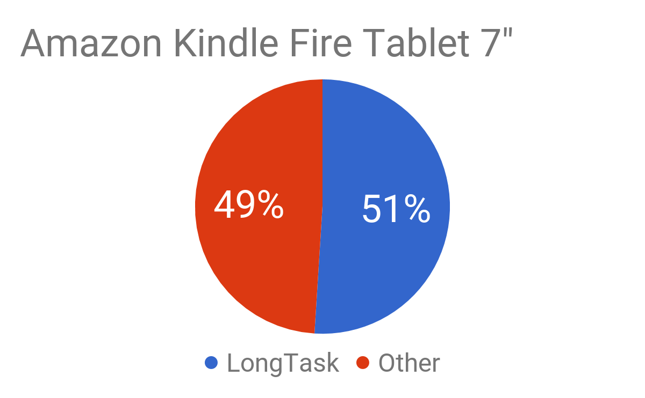
LongTask as % of Front End Load Time
Notes:
NJ
Look at modern fast device like S7
Compare to older lower end lower cost devices like fire tablet
Has 3x median LongTask time as modern device
Portion of time spent on LongTasks vs network

Slide 52
Older devices could be spending half of their load time on LongTasks.
Notes:
NJ
Important to test your sites on lower end / lower devices
Not just about networking
LT taking half load
Lower devices showed up as some of the top visitors in these sites

Slide 53
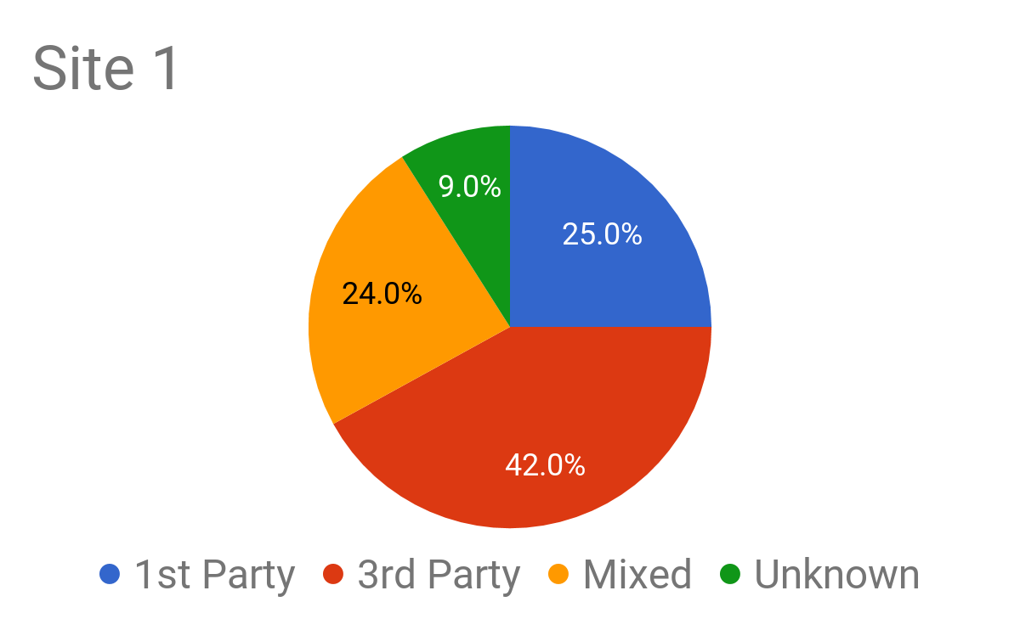
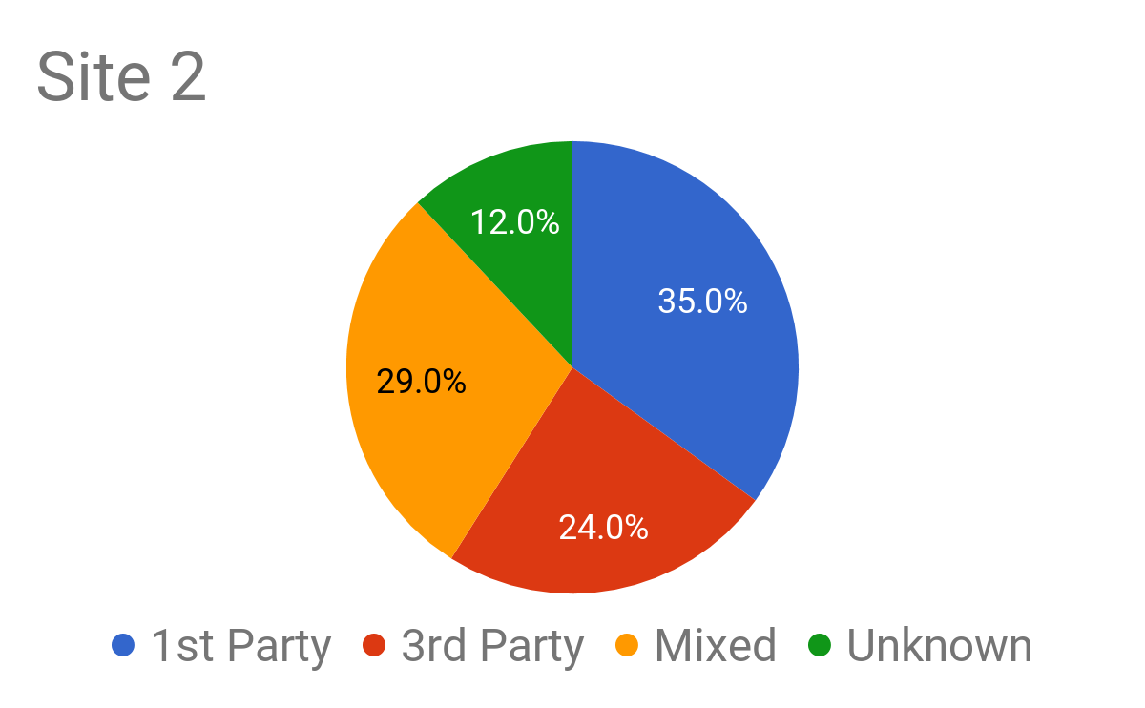
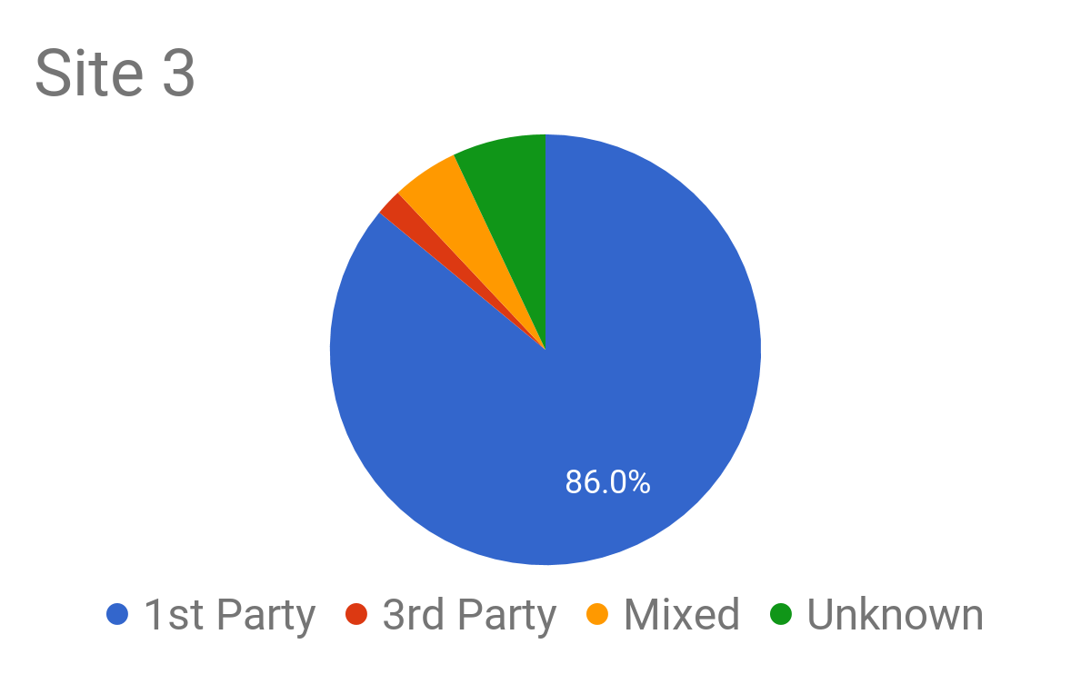
1st vs. 3rd Party
Notes:
NJ
1st vs 3rd depends on site

Slide 54
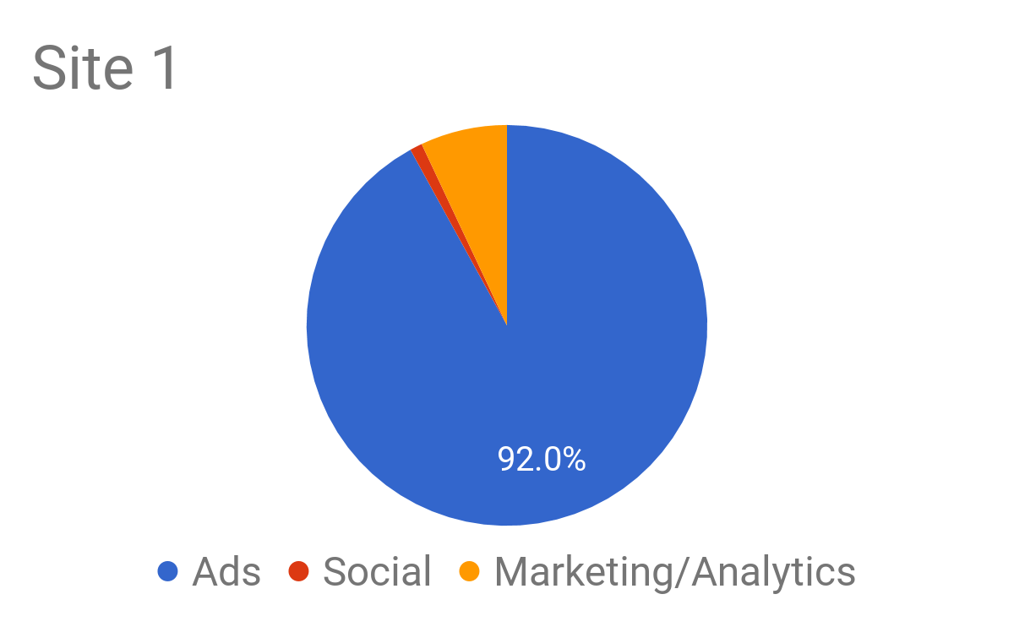
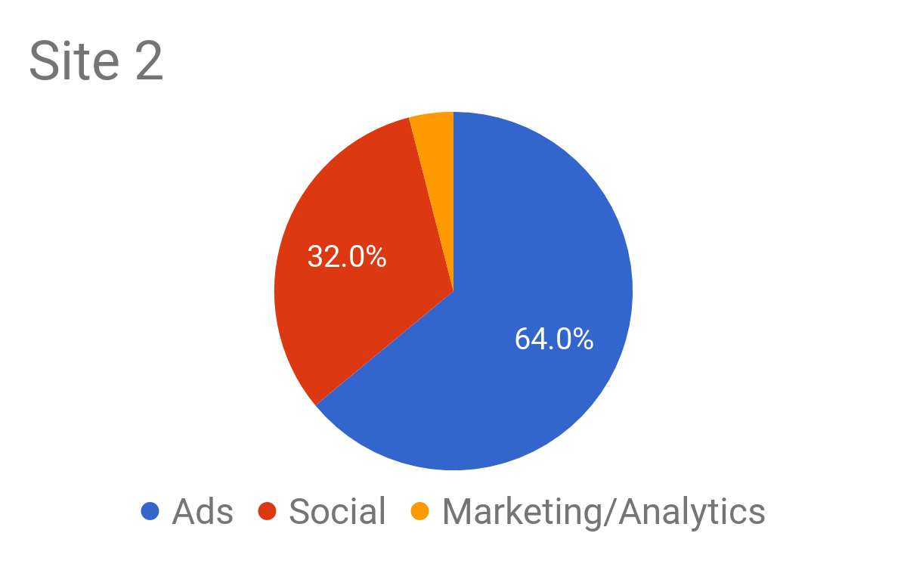
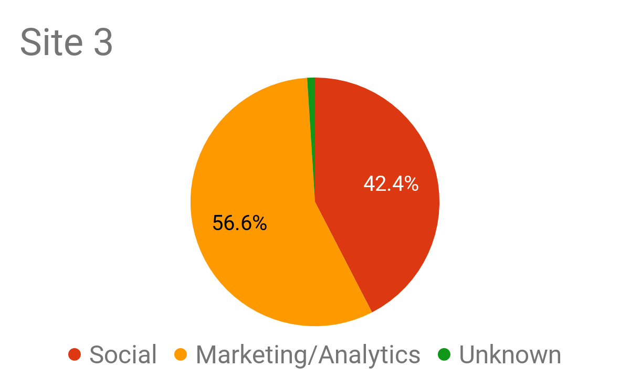
3rd Party Types
Notes:
NJ
Breakdown on sites
Do your own measurements
Your data will look completely different than these graphs
What’s important to you
What devices are having problems
What third-parties you should hold accountable

Slide 55

Optimizing Performance
Notes:
SP
So far we’ve covered:
set of new metrics,
code egs. and usage tips for measuring in the real world,
how metrics data can be analyzed to understand how users & business is affected. Imp to make the case for perf work.
Final segment: high level guidance for perf optimization journey

Slide 56
Every site is different.
Identify your core metrics.
Notes:
SP
Nic: imp to do your own measurements.
Also imp to set up your own core metrics.
TTI, Input Latency polyfills we provided won’t necessarily work out of box
baseline; Don’t assume they accurately capture your “usable” moment
customize TTI, for instance providing a lower bound that makes sense for your app
really hard to come up with generic metrics that work for everyon
BUT value in baseline metrics for majority case and provide starting point for others
*core building blocks like perf observer & long tasks that you can can use to build metrics

Slide 57
Minimize the time to TTI
Consider Mobile traffic
Ship less JS
Break up existing JS with Code Splitting
Notes:
SP
TTI recommended metric for loading perf for interactive apps
matters for business & conversion
imp to drive down TTI: identify primary interaction; Deliver critical JS asap
culprit: large bundles; split up JS
ideally ship less JS; or at least defer JS not needed yet - it’s expensive
eg. footer, pages not visited, features not used

Slide 58
Reduce Long Tasks
Mobile is especially hurting
Break up JS
Move intensive work off the main thread to workers
Notes:
SP
Cracking down on long tasks - key to addressing responsiveness issues
Ideally: drive down volume of long tasks
If prioritize: start with egregiously long;
in the way of TTI or Input Latency of critical interactions eg. checkout flow
Mobile is especially susceptible to long tasks; analyze mobile traffic
Scripts major culprit - break up scripts
Not just initial load: SPA nav, JS in response to clicks (checkout)
Move heavy-duty work off to worker
Deserializing & processing large binary format
Analyzing video or image analysis
background text analysis

Slide 59
Hold Third Parties Accountable
Identify the worst offenders
Evaluate impact on TTI & business metrics
Notes:
SP
Nic: 3rd party content (ads, social ..) major contributor to long tasks
single Ad can undermine all your perf work / code splitting etc
Ad or social widget can hurt TTI, Input Latency
Long tasks API attribution implicates 3P iframes
find out 3P damage on your site - decide if worth it; you have the tools
use metrics to evaluate different providers

Slide 60
Looking Ahead
Long Tasks V2
Input Latency + Slow Frames
Long Tasks is not Panacea
Notes:
SP
Work on responsiveness metrics is far from done. Really just getting started.
Long Tasks v2 - better attribution for script;
actively exploring Input Latency API to measure delayed input and when it delays rendering
Focussed on Long tasks and metrics around main thread contention BUT ..
Scroll latency and Animation jank can be caused by compositor system
eg. due to heavy rasterization work, or presence of too many layers
We want to build good metrics for these in the future.
call to action:
- try out polyfills & APIs; file bugs on github repos
- we want to hear from you! frustrations & successes
- perf imp to users; don’t accept gaps
- Push on Analytics to adopt new metrics
- link to slides

Slide 61
Thank You
Notes:
Thank them, and let them leave if they want to go to break
We'll be taking questions afterward if you want

